Slide 1
Parents School Uniform Survey 2026
Scoil Íde Primary School

Slide 2
What we wanted to find out!
Parental views on the relevance and function of the formal uniform in the school.
Parental views on whether school should move to a tracksuit only in classes from junior infants to first.
Parental views about potentially changing the fabric and design of the school tracksuit.

Slide 3
What we found out!
80/90 per cent of parents surveyed think the formal uniform promotes a sense of identity and belonging, and that it should be worn when representing the school.
58 per cent of parents surveyed feel children from juniors – 1st class should have both a formal uniform and a tracksuit, while 42 per cent feel it should be a tracksuit only.
Parents surveyed are almost 50/50 split on the suggestion of reviewing the design and fabric of the current school tracksuit.

Slide 4
Next steps…
The school will retain its crested formal uniform garments: sky blue cardigan/jumper and crested tracksuit.
In acknowledgement of the closeness of the figures relating to tracksuit versus tracksuit & uniform, the school is adopting a flexible approach to the wearing of tracksuits, especially in classes from junior infants to first class.
This means children in our junior classes may wear a tracksuit daily, and parents do not have to purchase the formal uniform if they do not wish to; however, the crested tracksuit is compulsory daily, and no alternative sports clothing will be allowed.
The school will review the fabric and design of the current tracksuit. This will commence next year, as per the views of all stakeholders, staff, children and parents.

Slide 5
Other information…
The school has a large stock of preloved crested uniform/tracksuit garments which are available on a case-by-case basis.
All other school clothing requirements are generic.
The school has an annual uniform sale run by the Parents’ Association, and uniform/tracksuits are sold at a very low cost.
The flexible approach towards the wearing of the tracksuit enables our younger children to wear their tracksuit daily.
School staff believe this flexible approach will be beneficial for children with sensory needs/additional needs/toileting needs, as well as promoting ease of movement.
Girls are permitted to wear formal navy trousers and a jumper as part of the formal uniform. This option has always been available.

Slide 6
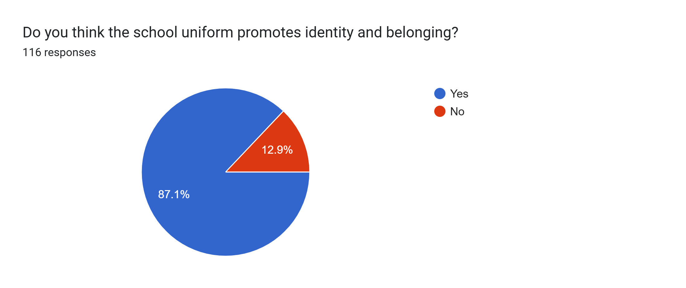

Slide 7
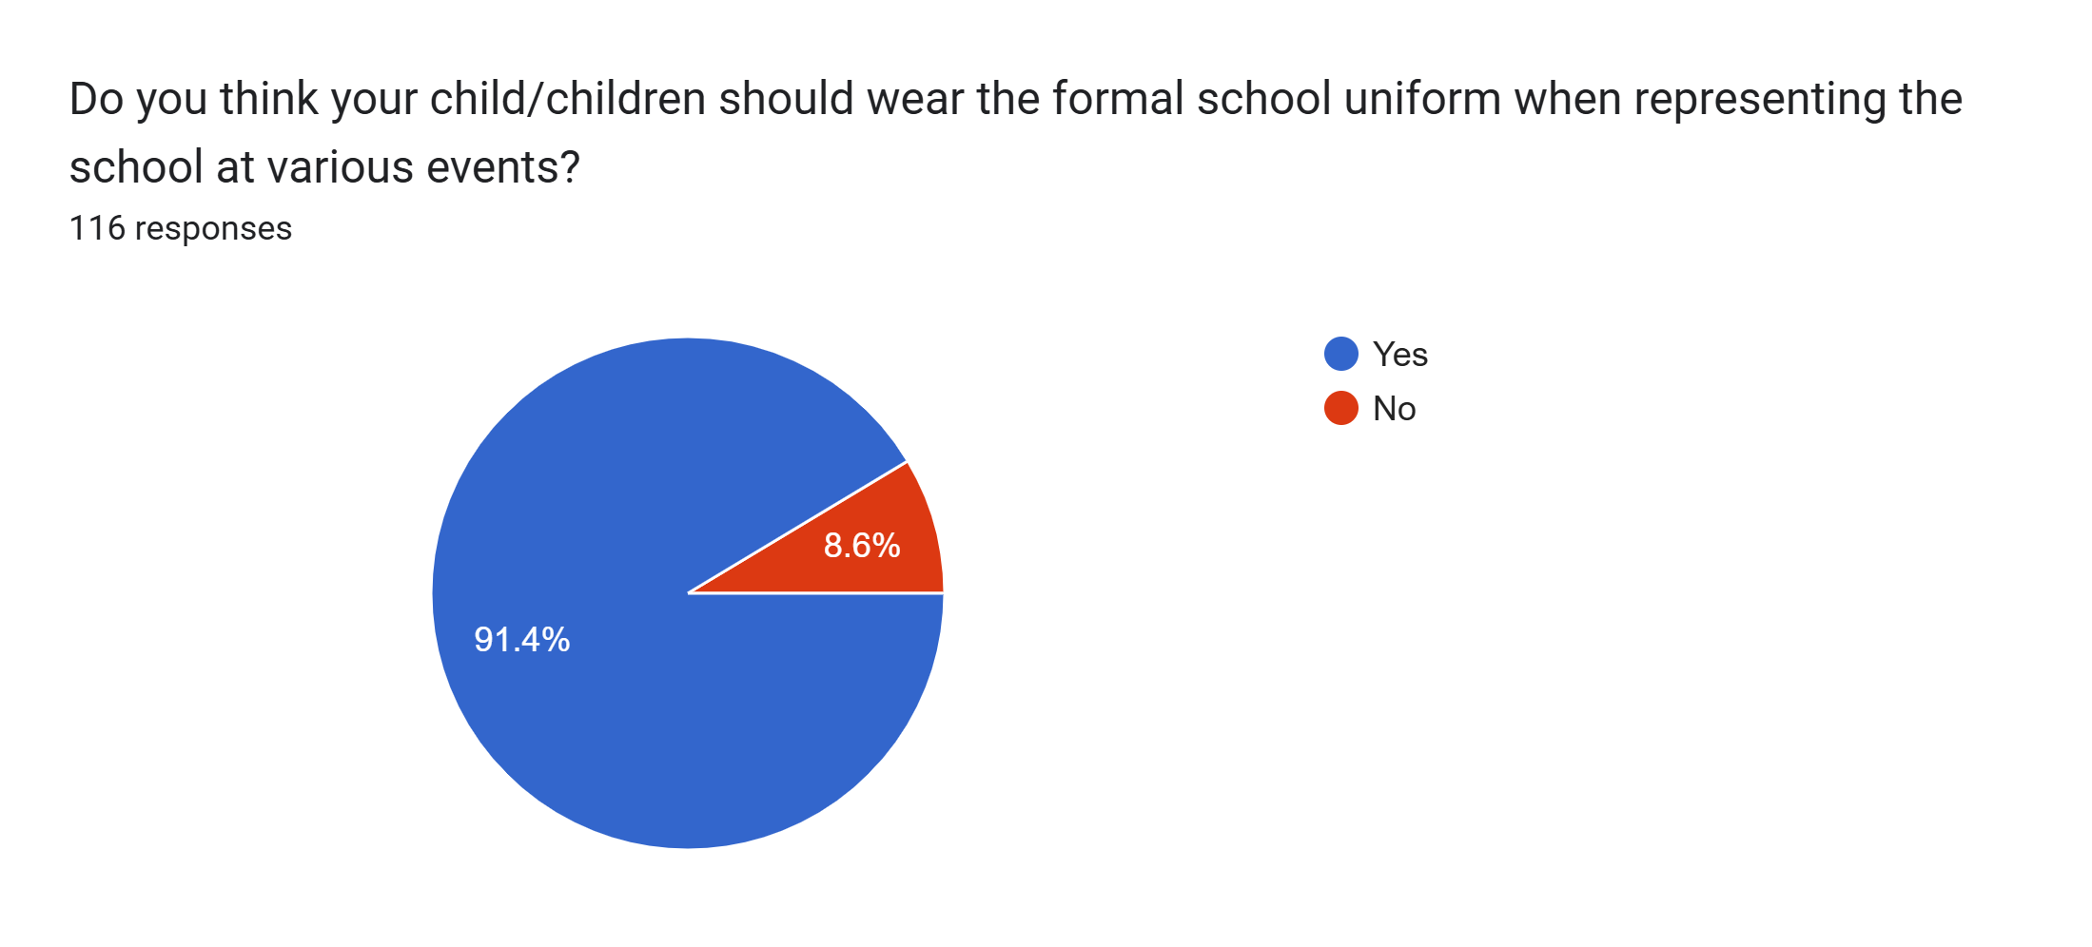

Slide 8
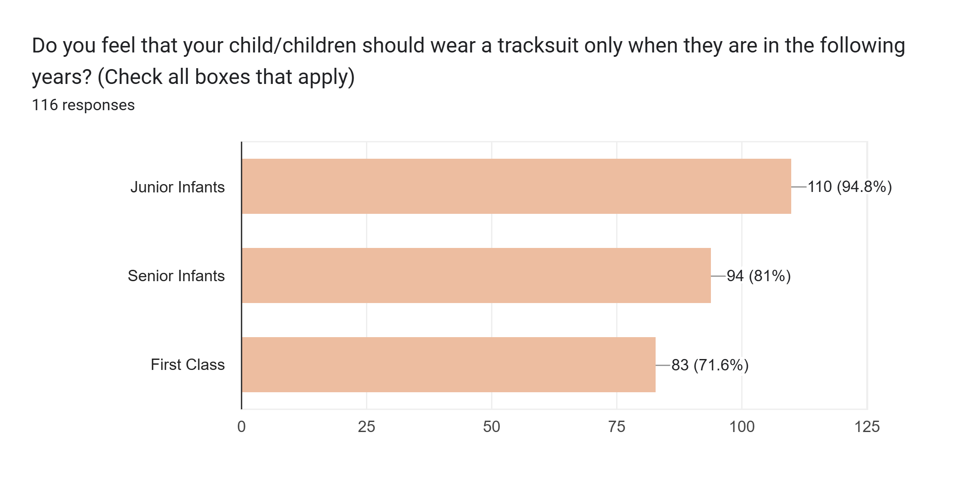

Slide 9
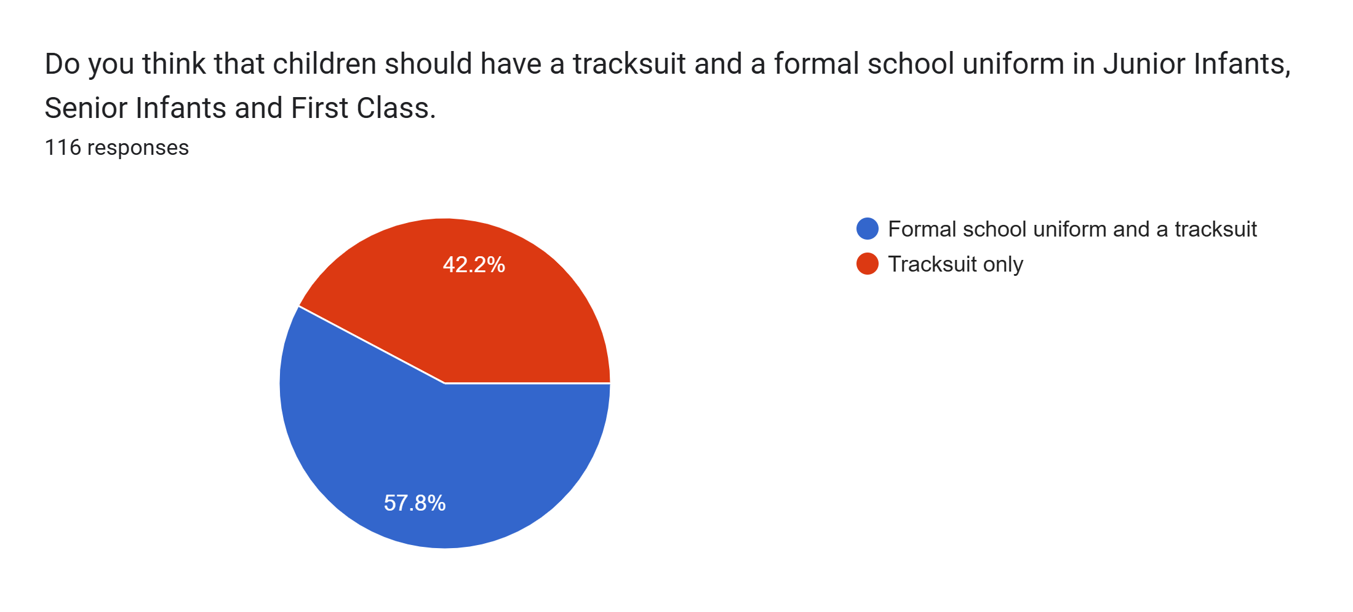

Slide 10
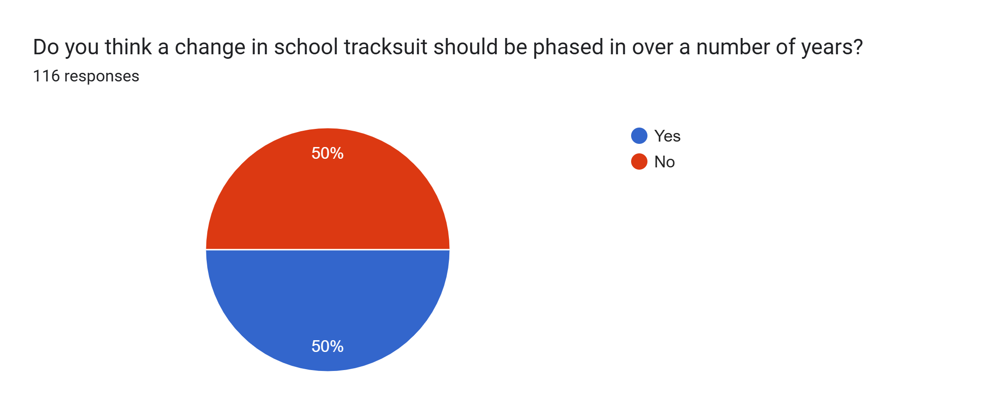

Slide 11


